Slide 1
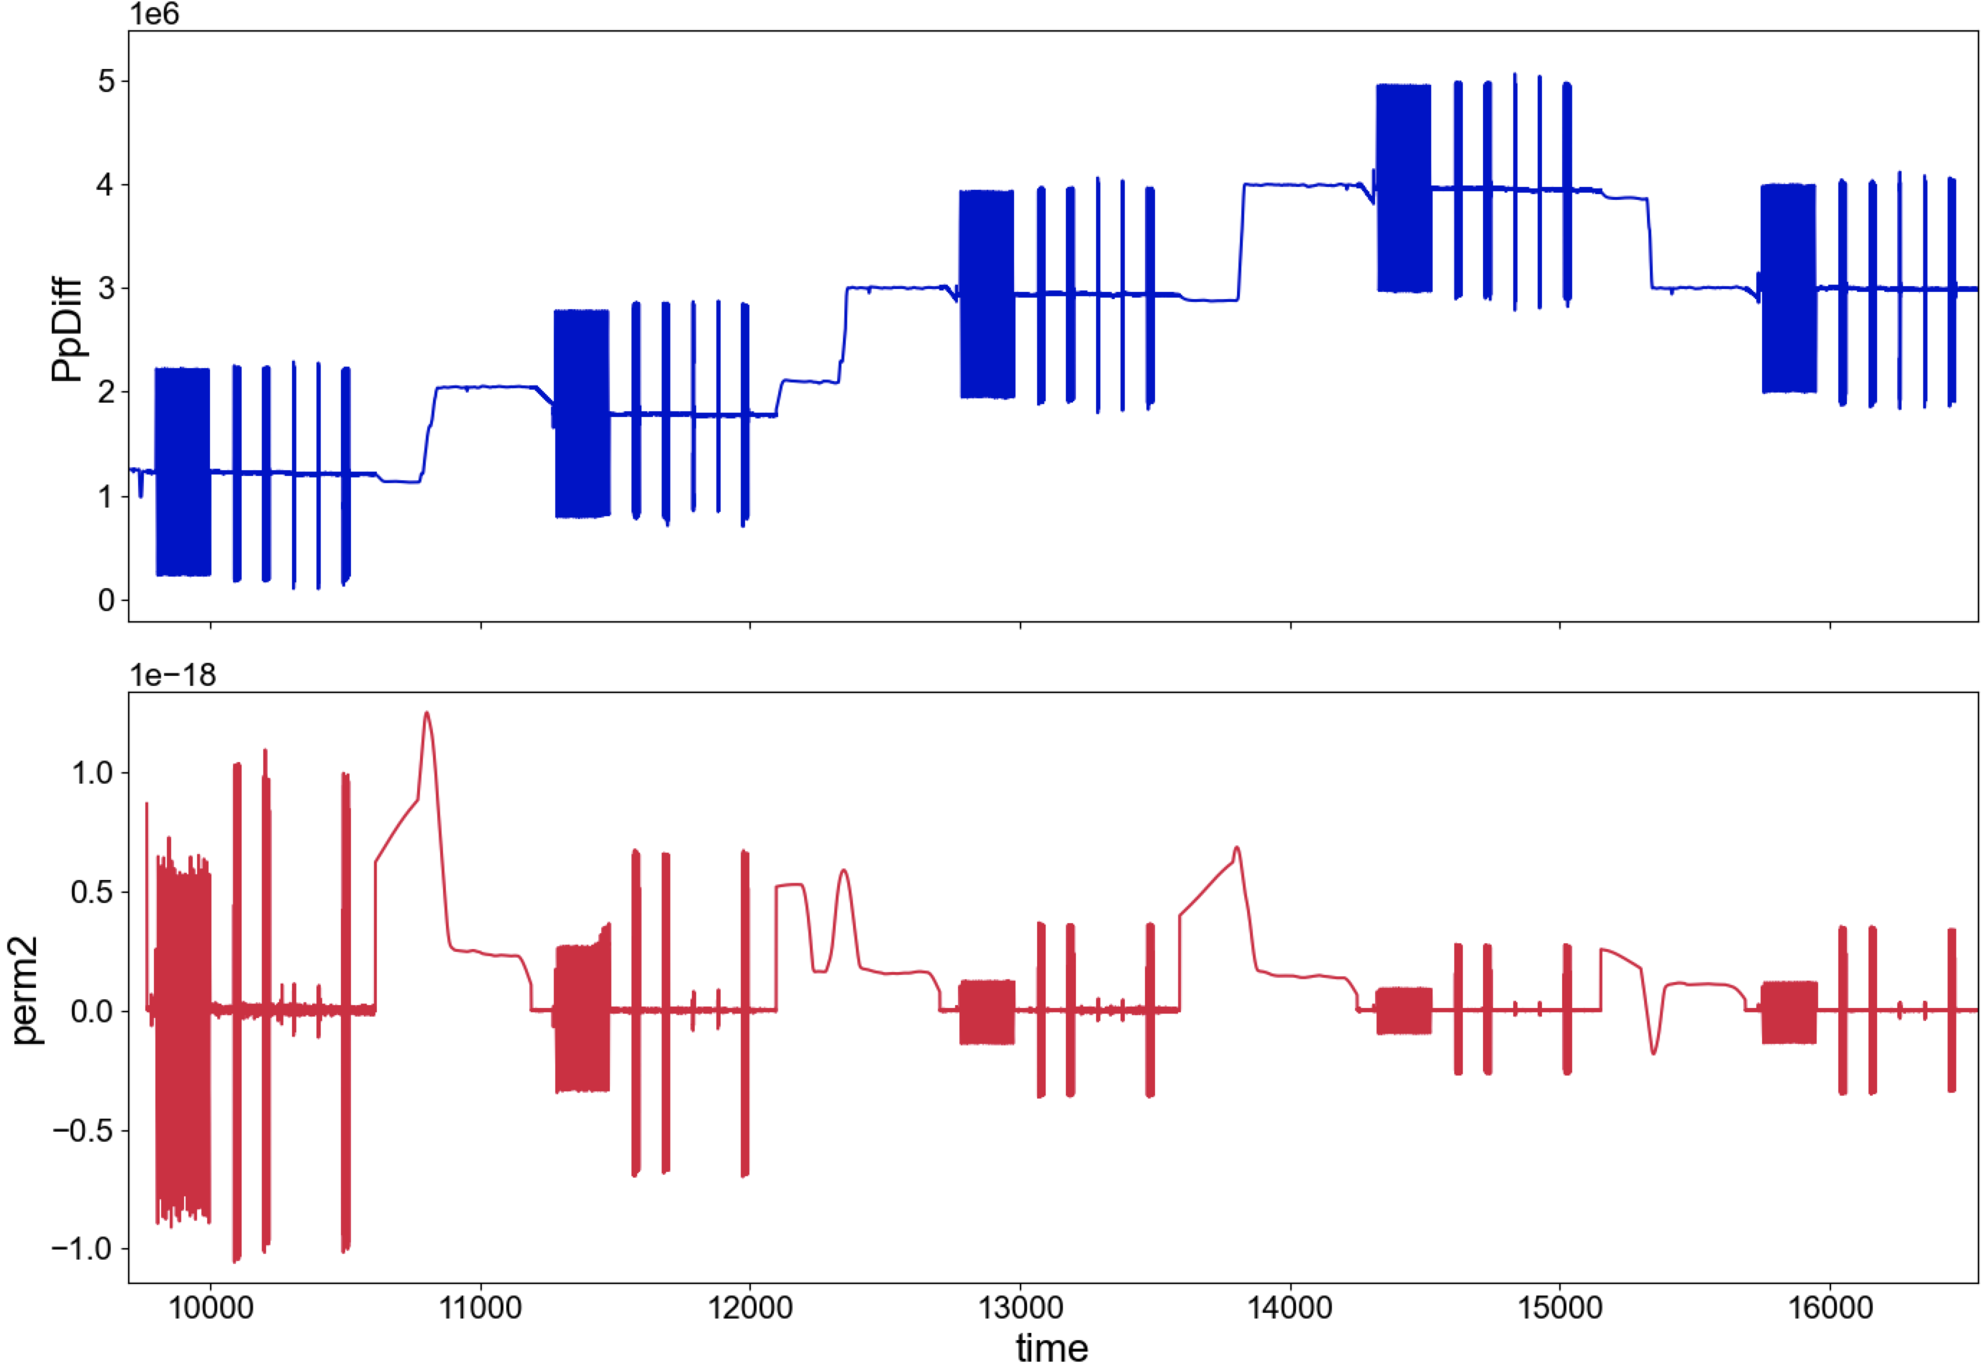
p5741
ΔPp (Pa)
Experiment: p5741
Surface: 80 grit
PP oscillations at 10 MPa eff NS.
Increase ΔPp: [1, 2, 3, 4] MPa
perm (m²)
time (s)

Slide 2
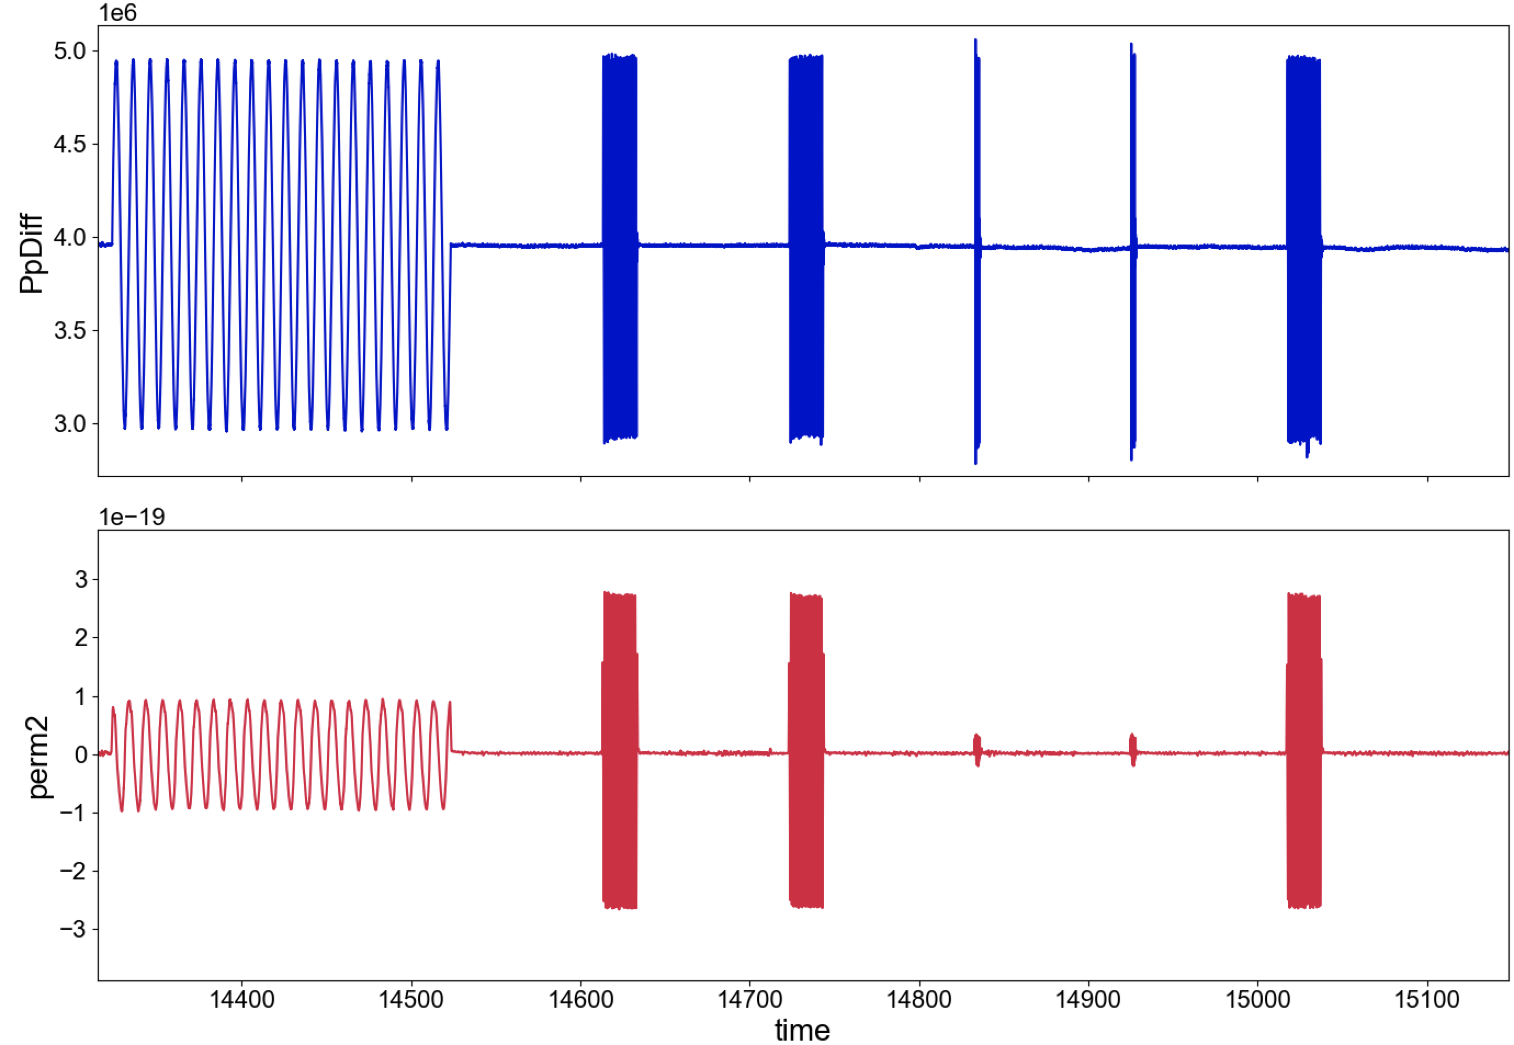
p5741
ΔPp (Pa)
Expect largest changes @ ΔPp = 4 MPa
Permeability calculated with on-board DCDTs for PpB & PpA intensifiers
Low-pass filter, 15 Hz
perm (m²)
time (s)

Slide 3
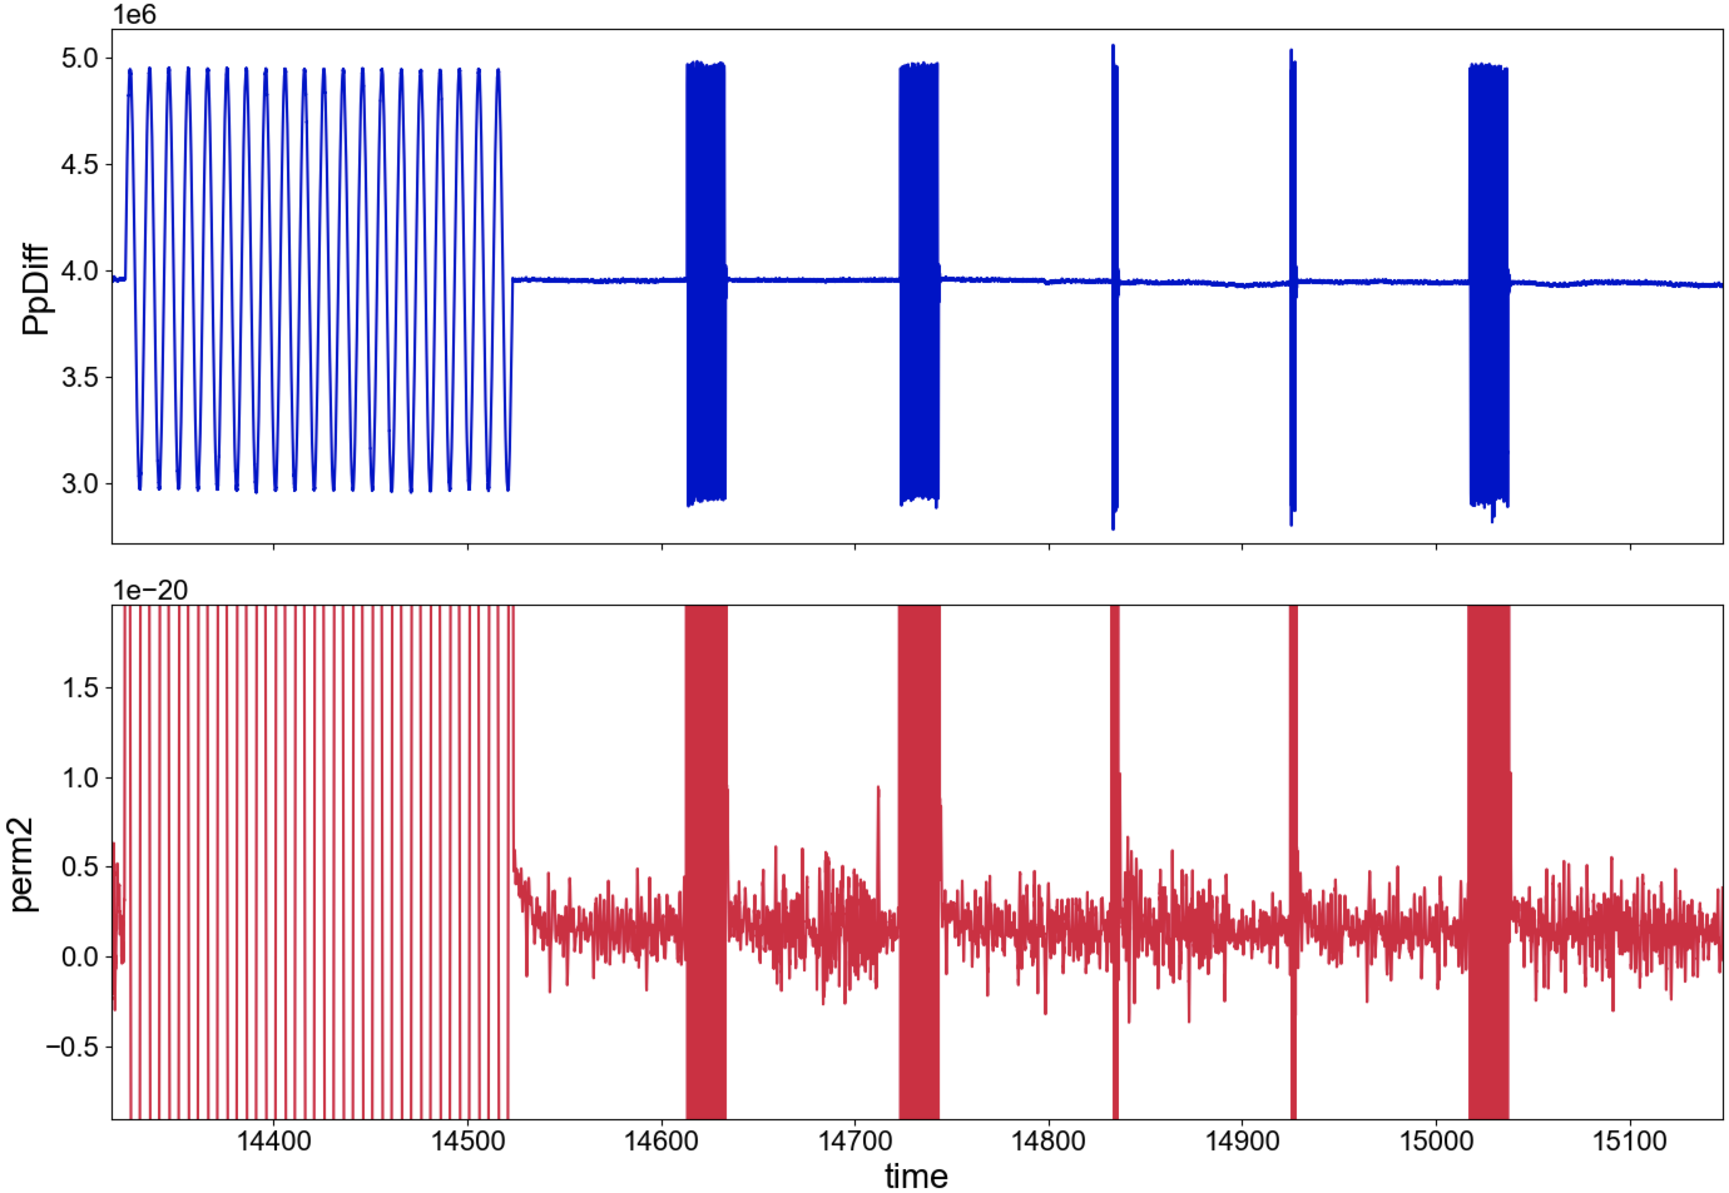
p5741
ΔPp (Pa)
Change in permeability ~ noise level.
perm (m²)
time (s)

Slide 4
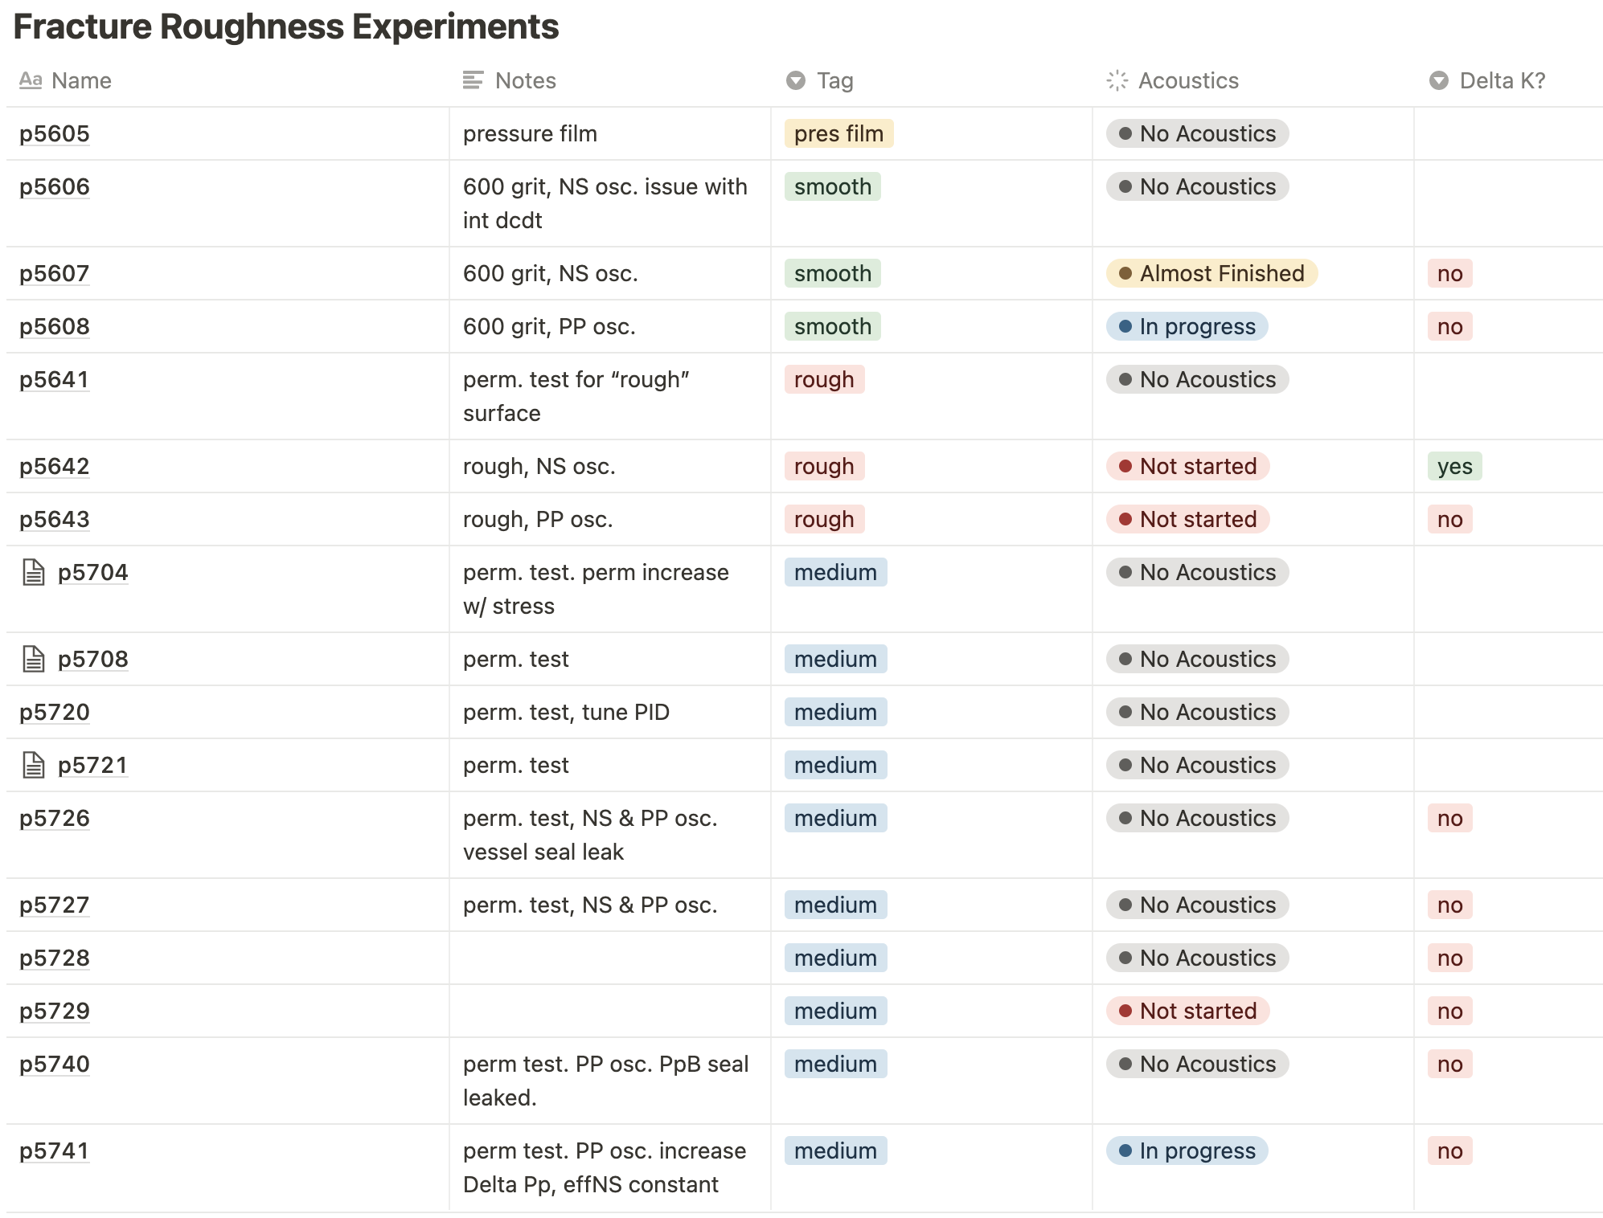

Slide 5
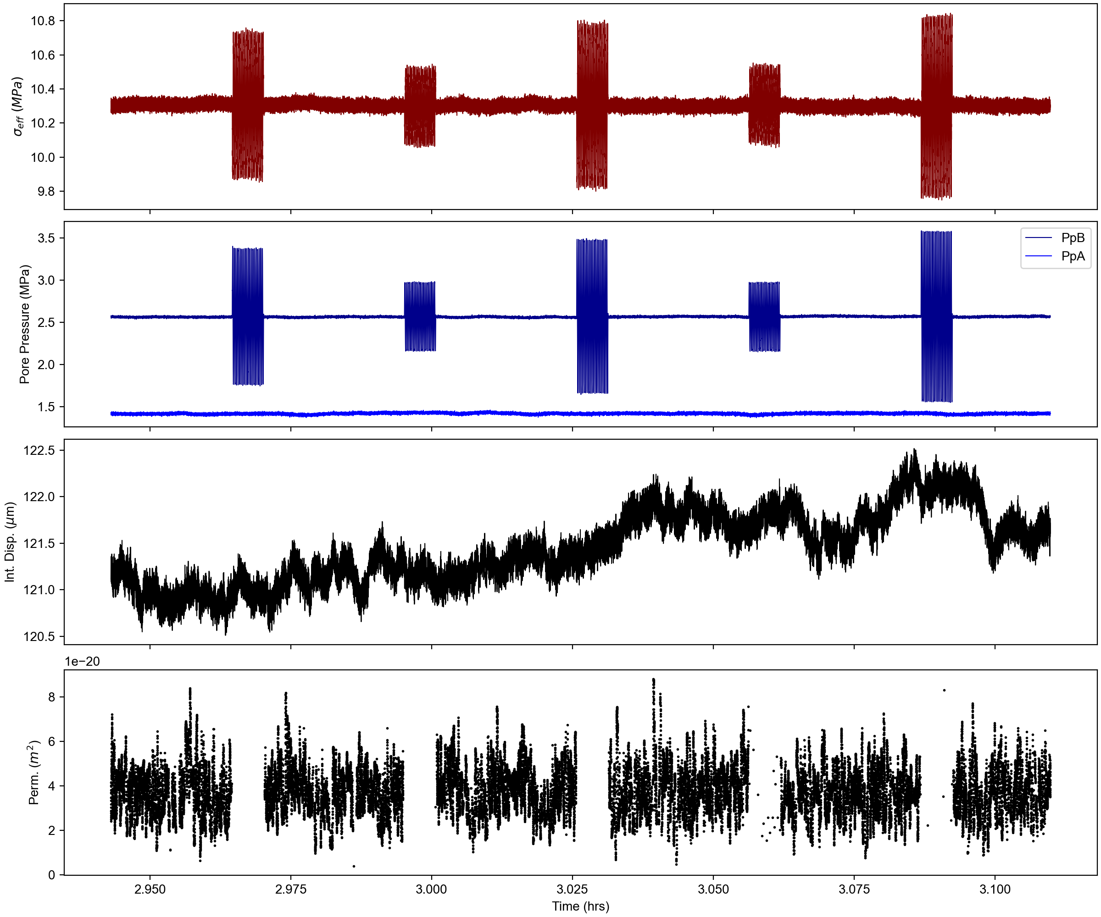
p5608
Experiment: p5608
Surface: 600 grit (smoothest)
PP, NS oscillations at [10, 12.5, 15, 17.5, 20] MPa eff NS.
Nominal permeability ~ 10⁻²⁰ m²
No Δk

Slide 6
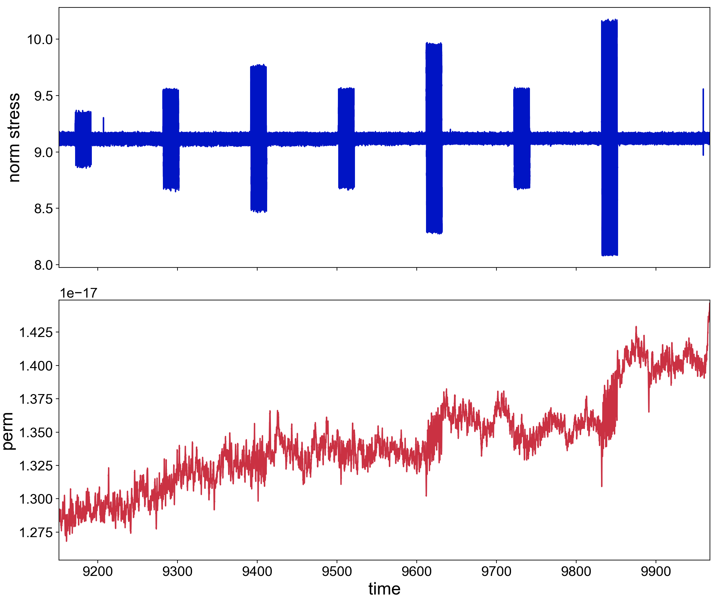
p5643

Slide 7
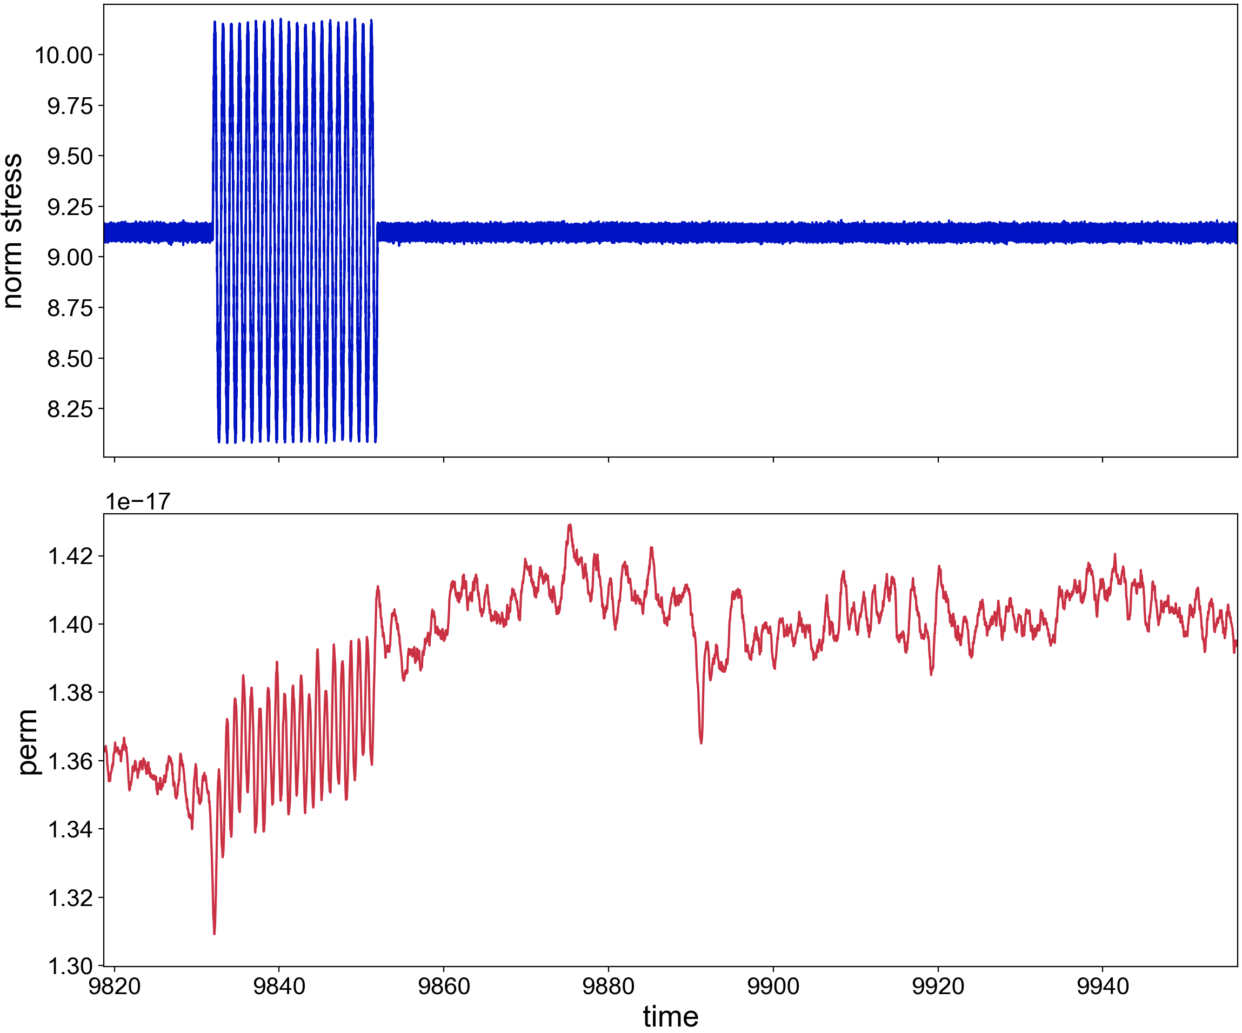
p5643

